Slide 1

Multi Class Obesity Prediction using Machine Learning
Our team is tackling the global obesity crisis through advanced machine learning techniques. We aim to develop accurate multi-class obesity prediction models to enable early interventions and support public health initiatives. Our team members include:
Hteik Tin Min Paing
Shivang Singh
Arya Gupta
Ishaa Budonkayala
Hussain Sakarwala
Nong Minh Hieu

Slide 2

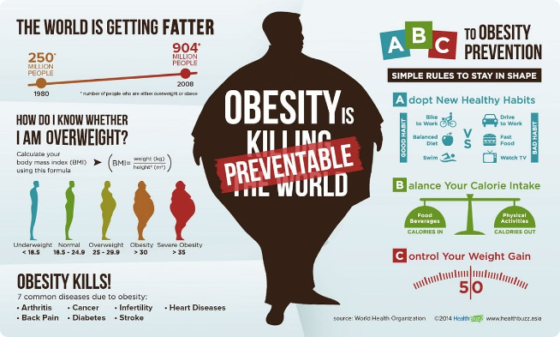
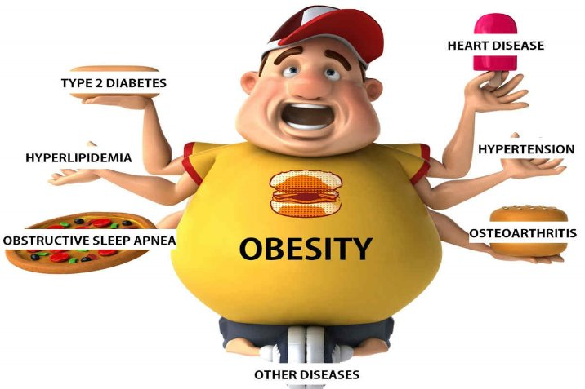
Introduction: Obesity as a Growing Concern
1
Global Crisis
According to WHO, obesity rates have tripled since 1975. In 2022, 2.5 billion adults were overweight, with 890 million having obesity. Overweight in children/adolescents rose from 8% (1990) to 20% (2022).
2
Health Impact
In 2019, WHO reported 5 million deaths from NCDs linked to high BMI (e.g., cardiovascular diseases, diabetes). Obesity increases the risk of several chronic conditions, leading to reduced quality of life and increased healthcare costs.
3
Personal and Societal Burden
Obesity is more than just a personal health issue; it's a global crisis impacting millions. It affects individuals, families, and healthcare systems worldwide.

Slide 3
Problem Statement
The Challenge
Key Questions
Our Approach
The rising prevalence of obesity poses significant health risks globally. Accurately predicting obesity based on individual factors can help in early intervention and prevention.
How can we utilize demographic and lifestyle data to predict obesity levels?
We aim to address these questions through comprehensive data analysis and advanced machine learning techniques, focusing on multi-class obesity prediction models.
Which factors most strongly correlate with obesity?
Can machine learning models improve the accuracy of obesity prediction?

Slide 4






Project Vision
Create Accurate Models
Develop precise obesity prediction models using machine learning techniques.
Enable Early Interventions
Provide personalized health insights to individuals at
risk of obesity.
Support Public Health
Enhance obesity management strategies and inform evidence-based health policies.
Advance Preventive Care
Shift healthcare focus towards proactive, data-driven
health strategies.

Slide 5


Dataset Overview
Source
Kaggle - Playground Series S4E2
Origin
Generated from deep learning model trained on Obesity or CVD risk data
Original Data
Web survey from users in Mexico, Peru, and Colombia (ages 14-61)
Records
20,758
Features
17 (e.g., Eating habits: FAVC, FCVC; Physical condition: FAF, TUE; Demographics: Age, Gender, BMI)
Target
NObeyesdad (Obesity levels: Underweight, Normal, Overweight I,II, Obesity I, II, III)

Slide 6


Data Description
Demographic Data
Family & Lifestyle
Eating & Drinking Habits / Transportation
Gender: Female/Male
FHWO: Overweight Family Member (Yes/No)
CAEC: Snacking Frequency
Age: Numeric (Years)
Height: Numeric (Meters)
FAVC: High-Calorie Food Consumption (Yes/No)
CH2O: Water Consumption(Liters/Day)
Weight: Numeric (Kilograms)
FCVC: Veggie Meals Frequency (Numeric)
CALC: Alcohol Consumption
Body Mass Index: Numeric
MTRANS: Mode of Transport
NCP: Main Meals per Day (Numeric)

Slide 7
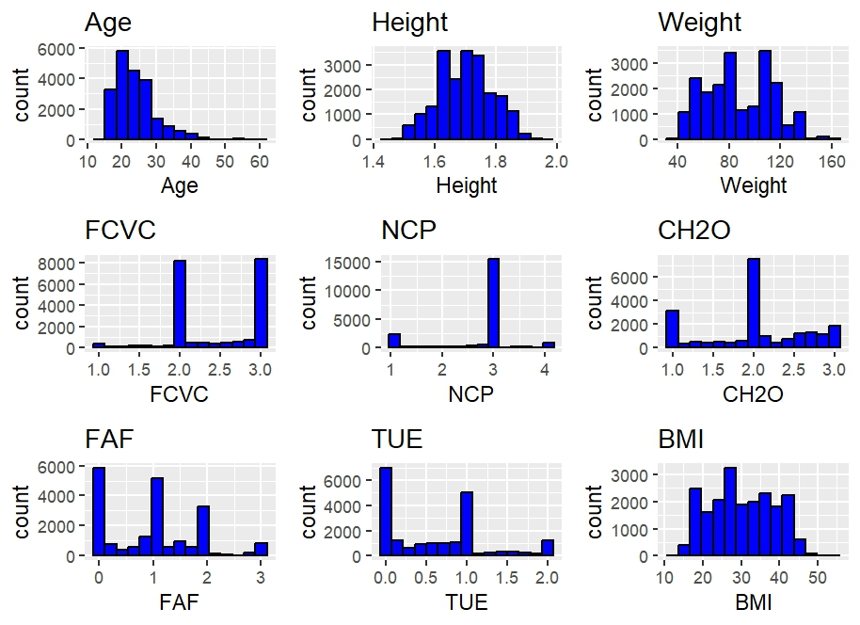
Summary of the dataset
Numeric Variables: Age, Height, Weight, FCVC, NCP, CH2O, FAF, TUE.
Categorical Variables: Gender, Family History, FAVC, CAEC, SMOKE, SCC, CALC, MTRANS, Nobeyesdad.

Slide 8
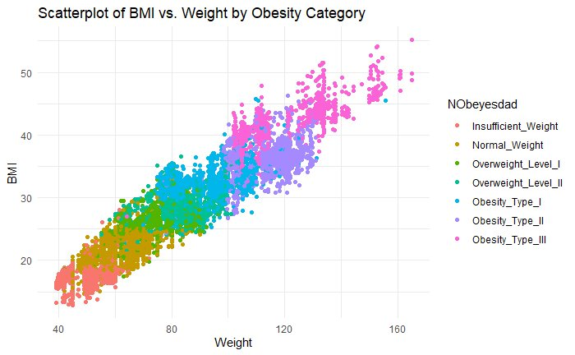
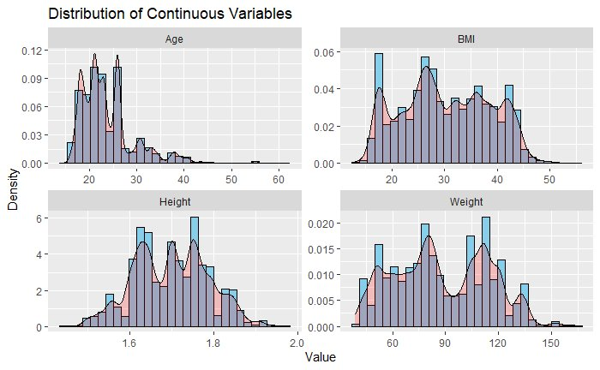
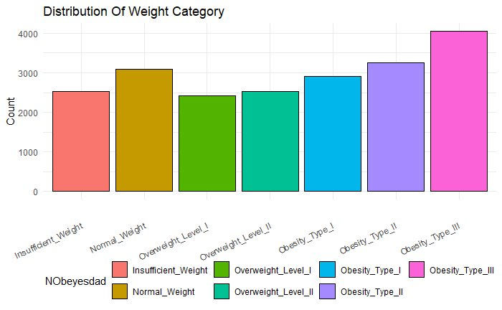
Exploratory Data Analysis

Slide 9
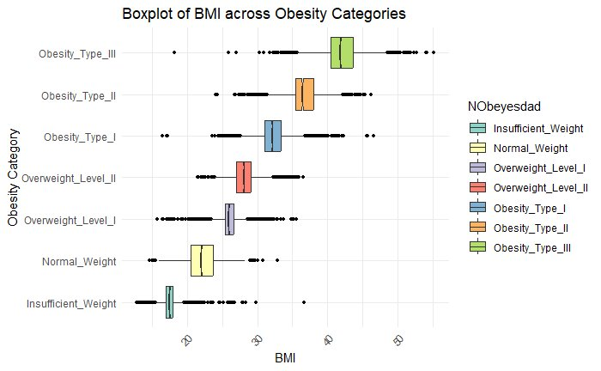
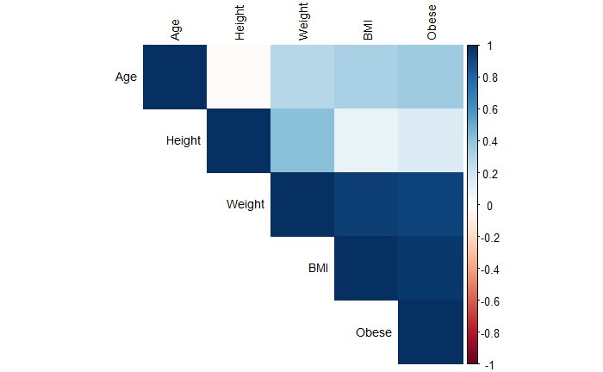
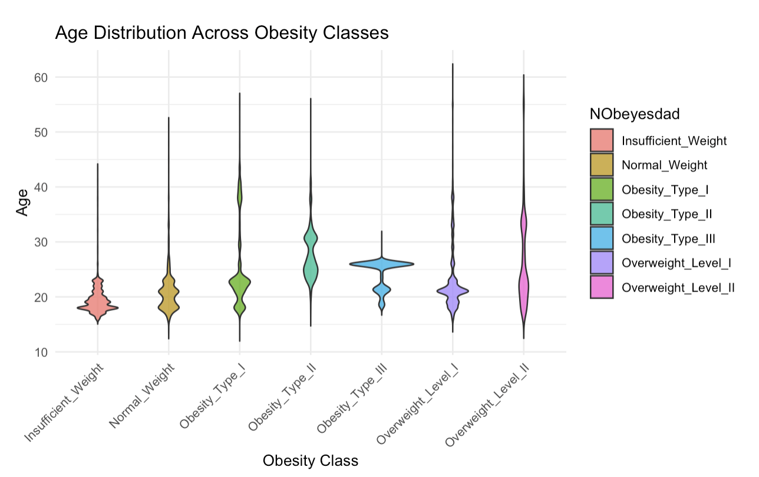
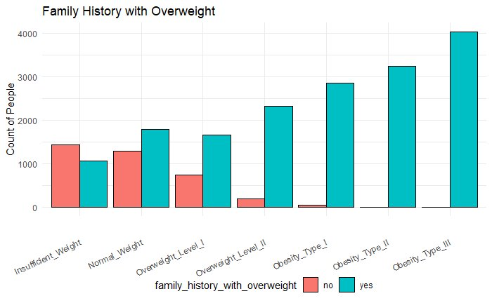

Slide 10



Methodology: Logistic Regression
Linear Classifier
Logistic regression models the probability of class membership using a linear relationship
between features and the log-odds of the target class.
Sigmoid Function
It uses a sigmoid function to map predicted values to probabilities, constrained between 0
and 1.
Threshold- Based Classification
Predictions are classified based on a probability threshold, typically 0.5, to determine class
labels.

Slide 11
Methodology: Support Vector Machines
Optimal Hyperplane
SVM constructs a hyperplane or set of hyperplanes in a high-dimensional space to classify
data points
Maximizing Margin
The model maximizes the margin between different classes to ensure better generalization
on unseen data.
Kernel Trick
SVM uses kernel functions to handle non-linearly separable data by mapping it to a higher
-dimensional space.

Slide 12
Methodology: XGBoost
Data Preparation
With One Hot Encoding and Scaling applied to the dataset to feed into xgb.
Model Setup
With tuned hyperparameters like learning rate, tree depth and sub sampling.
Evaluation
Using a confusion matrix for accuracy, precision and recall.

Slide 13
Methodology: Decision Tree
Recursive Building
Recursively builds a tree of binary conditions to separate data.
Optimal Conditions
For a given group of data, the optimal binary condition is decided based on an impurity
measure.
Impurity Measure
A classic example of impurity measure is the Shannon entropy.

Slide 14
Performance Metrics of Decision Tree
Algorithm
Accuracy
Precision
Sensitivity/Recall
F1
AUC
Rpart algorithm
83.45%
83.51%
83.45%
83.34%
89.56%
C5.0 algorithm
87.40%
87.39%
87.40%
87.38%
92.02%
These are average metrics across all 7 classes.

Slide 15
Methodology: Random Forest
Overfitting Solution
Random forest is a method to tackle the prone-to-overfitting drawback of decision
tree.
Ensemble Method
RF is an ensemble method comprises of independently weakly trained decision trees.
Aggregation
The final prediction is decided using an aggregation operator. For example, averaging
or voting.

Slide 16
Random Forest Results
Model
Accuracy
Precision
Sensitivity/Recall
F1
AUC
Baseline model - BMI
90.17%
90.12%
90.17%
90.12%
93.71%
Ft Engineering
90.47%
90.40%
90.47%
90.42%
93.92%
Up-sampling FE
90.65%
90.61%
90.65%
90.62%
94.07%
Up-sampling
90.32%
90.30%
90.32%
90.30%
93.83%
Down-sampling FE
90.34%
90.33%
90.34%
90.32%
93.89%
Down-sampling
90.20%
90.22%
90.20%
90.20%
93.79%

Slide 17
Comparative Analysis of all Models
Model
Accuracy
Precision
Sensitivity/Recall
F1
AUC
Random Forest
90.65%
90.61%
90.65%
90.62%
94.07%
XGBoost
88.6%
87.74%
87.27%
87.36%
92.69%
Decision Tree
87.40%
87.39%
87.40%
87.38%
92.02%
SVM
88.06
87.97
88.0%
88.0%
92.41%
Logistic Regression
85.71%
85.60%
85.7%
85.6%
90.91%

Slide 18
Conclusion & Interesting Findings
1
Feature Engineering Impact
2
Key Attributes
3
Performance Indicator
Some attributes (BMI, family history, FAVC,CAEC) have stronger correlation with the predicted variable (obesity type).
F1 is a more balanced indicator of the model's performance as it accounts for Precision + Recall.
Feature engineering helps improve the model (works for logistic, decision tree & random forest).
4
Insights
Age and Gender also show variation in obesity levels, with males and individuals above the age of 30 having higher obesity rate.

Slide 19
Key Takeaways
Public health initiatives should focus on promoting balanced diets and encouraging physical activity, especially in populations with a family history of obesity (e.g., Healthier SG)
Healthcare professionals can leverage these insights to tailor obesity intervention programs
The insights from this study can be adapted to other regions or expanded datasets, making the model scalable for global obesity prediction efforts. This scalability can enhance international health strategies by applying machine learning to similar obesity-related datasets worldwide.
The Random Forest model achieved the highest accuracy at 90.67%, making it the most reliable predictor of obesity among all tested models. Its ensemble approach effectively mitigates overfitting while maintaining high precision and recall, making it a strong choice for real-world applications in obesity prediction.

Slide 20


Slide 21


